Slide 1
DBMS PROJECT
GROUP 10: University Event
Management System
Under the guidance of
Dr. Sangeetha G
Team Members: Ananya Sreewastav 2241115
Brito Jaison 2241123
Parth Sharma 2241150

Slide 2
ABSTRACT
The University Event Management System or UEMS is a comprehensive web based application which provides one stop solution for hosting events and providing students of the campus with a platform to stay updated with all the events happening in the campus and attend them.
The UEMS enables the organisers from various departments,clubs and other festing bodies to display relevant information of their event with all the necessary details such as time,venue,date and even provide information about attendance claims.
On the user side, students would be able to view all the events and fests happening around the campus and would even be shown events based on their deanery
SDG GOALS
SDG 4: Quality Education
SDG 9: Industry, Innovation, and Infrastructure
SDG 8: Decent Work and Economic Growth

Slide 3
AGENDA
ABSTRACT
INTRODUCTION
EXISTING SYSTEMS
LIMITATIONS OF EXISTING SYSTEMS
PROPOSED SYSTEM
FLOW DIAGRAM
REQUIREMENTS ANALYSIS
1)Software requirements
2)Hardware requirements
3)Network requirements
IMPLEMENTATION AREAS
UI MODELS
DATABASE

Slide 4
INTRODUCTION
Effortless Event Creation: Plan and create events easily with our intuitive interface. Add details, manage registrations, and even upload promotional materials in a few clicks.
Visibility for All: Showcase your event to the entire student body! Our system ensures your event reaches its target audience through integrated campus calendars, social media promotion tools, and targeted email notifications.
Student-centric Design: Find the perfect event for you! Students can browse upcoming events by category, date, or keyword, ensuring they never miss out on exciting opportunities.
Seamless Registration: Registering for events has never been easier! Students can sign up for events directly within the system, with secure payment processing and automatic confirmation emails.
Data-driven Insights: Gain valuable insights into student engagement. Track registration trends, analyze popular event types, and make informed decisions to cater to the students' interests.

Slide 5
EXISTING SYSTEMS
The current system follows organisers spreading news about the events either by going class to class or through email notifications.
Other forms is spreading information through WhatsApp groups and uploading posters on Knowledge Pro Website.
There is no centralized system to create events and edit details which can be conveyed to attendees in Realtime.

Slide 6
Limitation of Existing Systems
The current system does not provide the users information about all the events which happen in the university.
Users are not provided with notifications about events of their preferences.
Information about inter-department events is not available to all the students.
Organisers do not have a centralized system for organising events and marketing them in the university.

Slide 7
Proposed System
Our Website overcomes the challenges faced by the students of our university
Here’s how:
We provide a easy to use website to each and every student which gives them a platform where they get knowledge of all the fests and events happening in our campus
It also makes registration easy as after viewing a fest we also give them the option to register then and there itself
It also provides a convenient platform for clubs and users to create/edit or delete an event

Slide 8
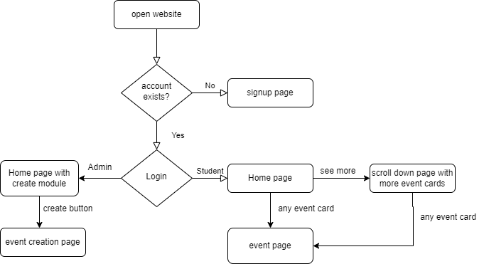
FLOW DIAGRAM

Slide 9
Requirements Analysis
Functional requirements:
Software should have all details of all schools
It should provide student view and host view
It should have option to create and edit an event
User can register to events and user should be notified about the event

Slide 10
Requirements Analysis
TECHNICAL REQUIREMENTS
Performance : The user must have a secure internet connection through which they can access the website.
The performance of the website depends on the system specifications of the user and the browser they are accessing it with Data Security
The information stored by the security is stored in a secure manner such as students account and passwords Data Storage
The data is securely stored in a database
The database can only be accessed by authenticated admins of the software Reliability
The website is well designed with attractive colour palettes for good user interface
It is optimized for easy access and working of users so that anyone can easily do a fest registration

Slide 11
Requirements Analysis
SYSTEM REQUIREMENT
Hardware requirements Processor :2 core or higher
Os : windows 10 or higher Storage: 3gb Ram : 4GB Network card
Software requirements DBMS:
mysql/mongoDB
Server: PHP/ Express.js
Framework: React.js
NETWORK REQUIREMENTS Network:
Google Chrome / Mozilla or equivalent WIFI: Internet Required.

Slide 12
Implementation areas
Our application can be used by every student and club of Christ University and be scaled up to be used by other universities and colleges as well

Slide 13
USER INTERFACE

Slide 14
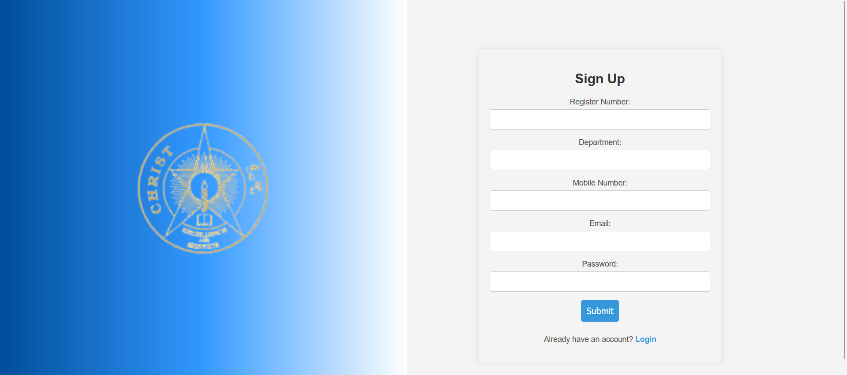
UI MODULES
SIGN UP

Slide 15
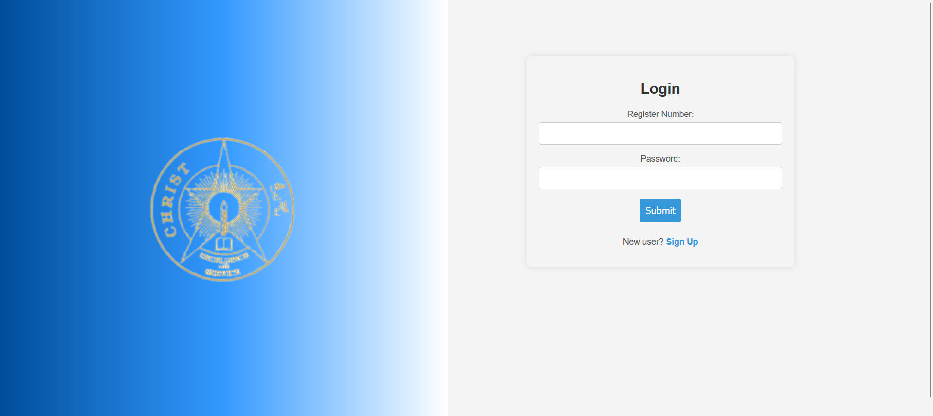
UI MODULES
LOGIN

Slide 16
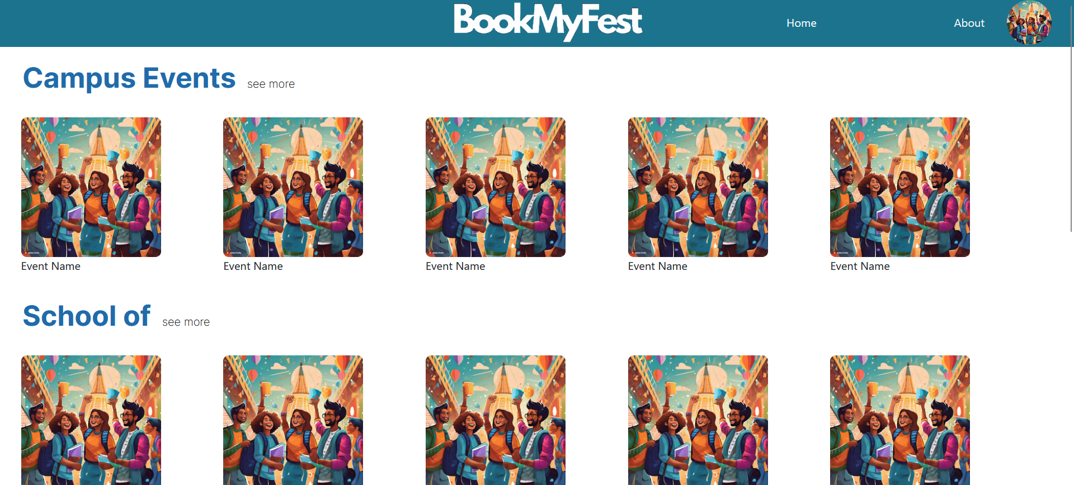
UI MODULES
HOME PAGE –USER

Slide 17
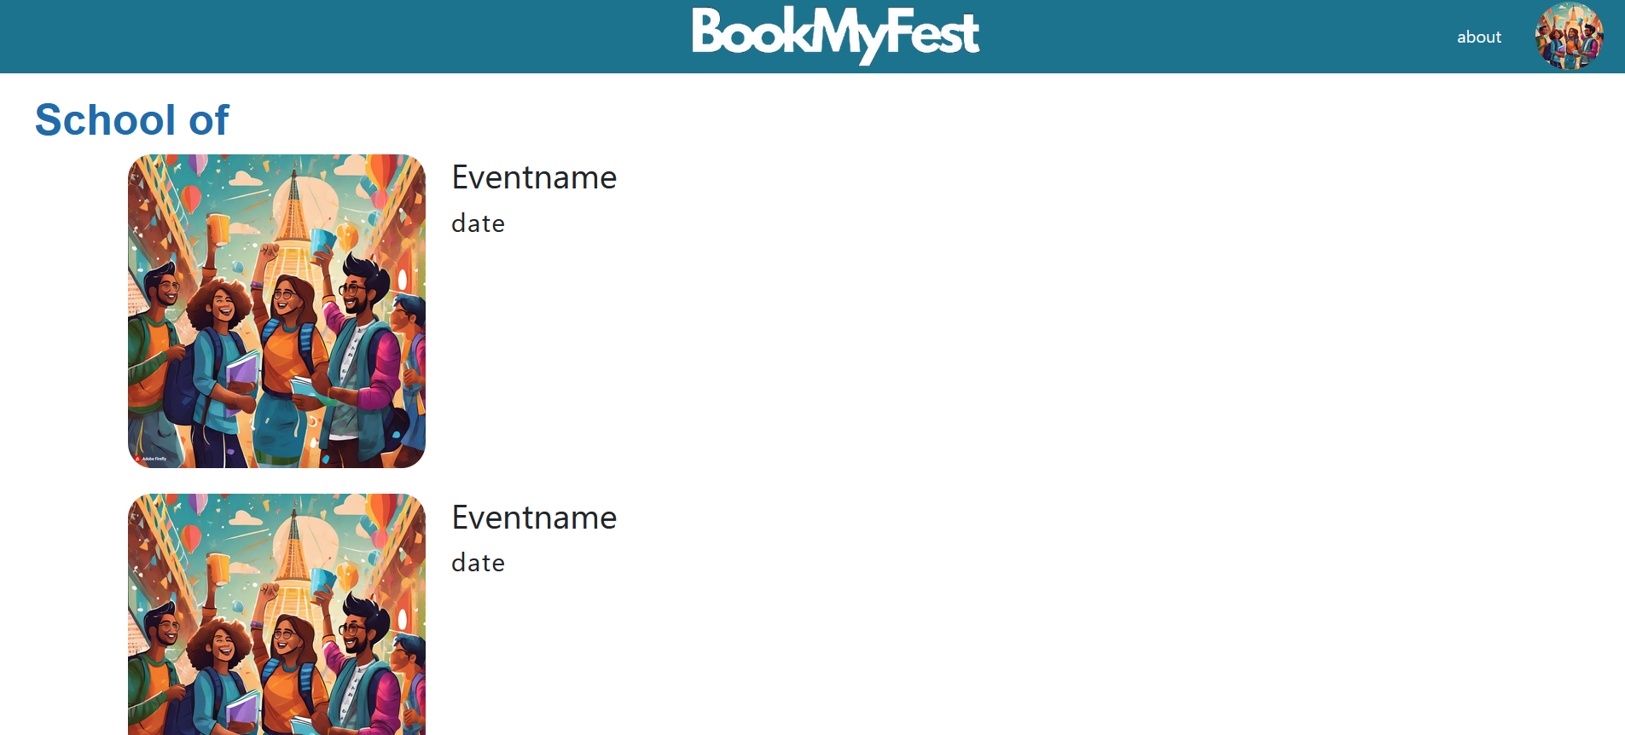
UI MODULES
SEE MORE PAGE

Slide 18
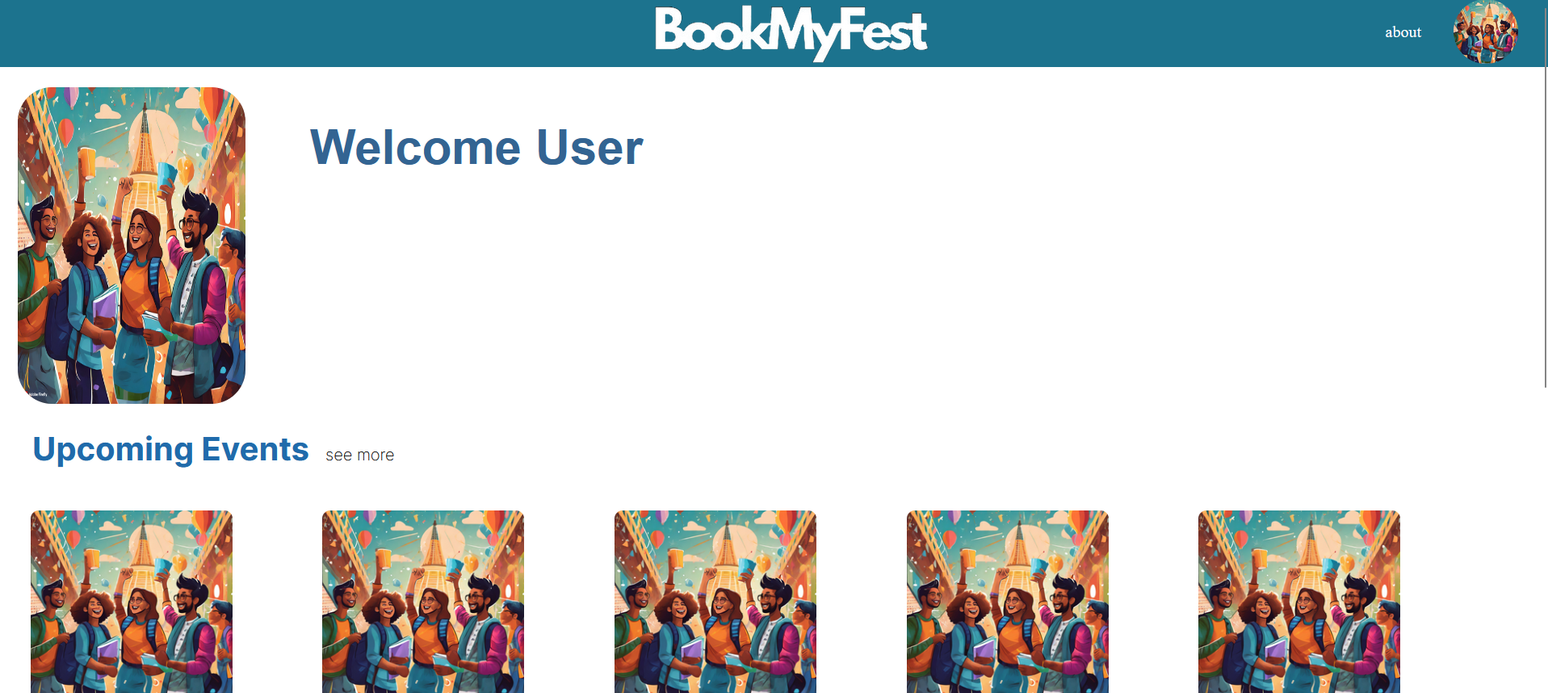
UI MODULES
USER PROFILE

Slide 19
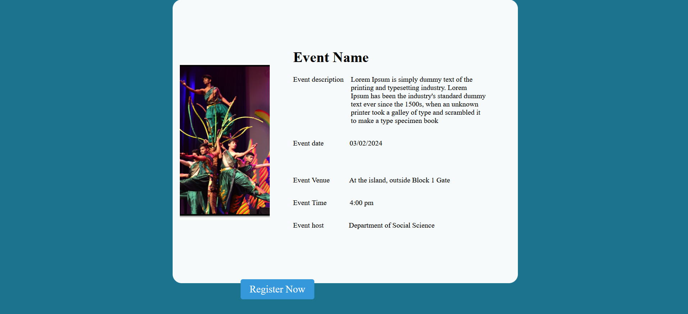
UI MODULES
FEST PAGE

Slide 20
DATABASE

Slide 21
About MYSQL
MySQL reigns as a dominant open-source relational database, powering countless websites and apps. Known for scalability, security, and user-friendliness, it caters to projects both big and small. Its intuitive SQL language and vast community support make it perfect for beginners and veterans alike. From simple blogs to complex e-commerce platforms, MySQL's flexibility and feature-richness adapt to diverse needs. While not suited for every enterprise scenario, its affordability and popularity make it a top choice for anyone seeking a reliable and powerful database solution.

Slide 22
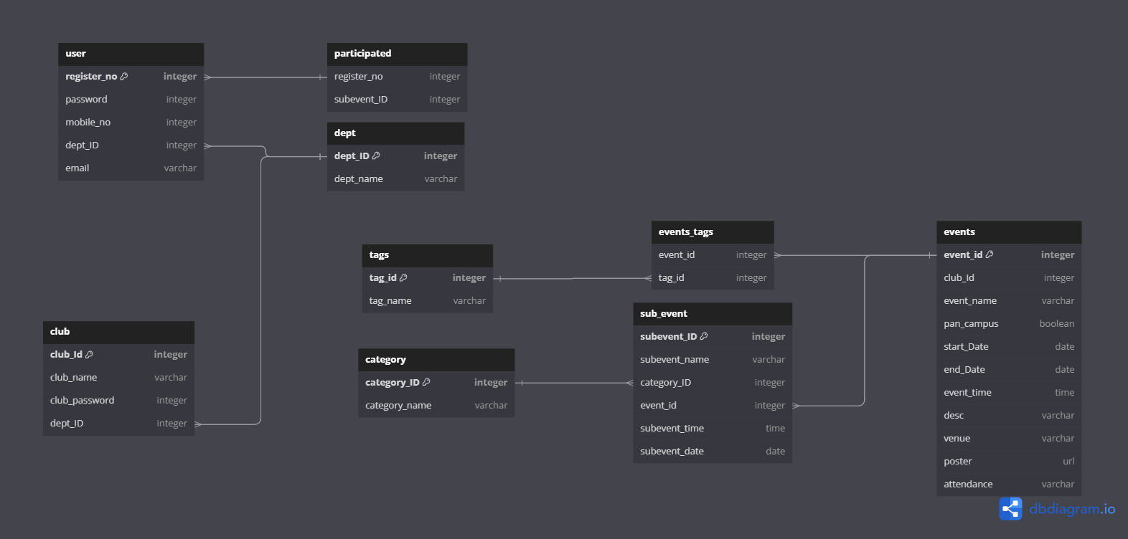
DATABASE
SCHEMA:

Slide 23
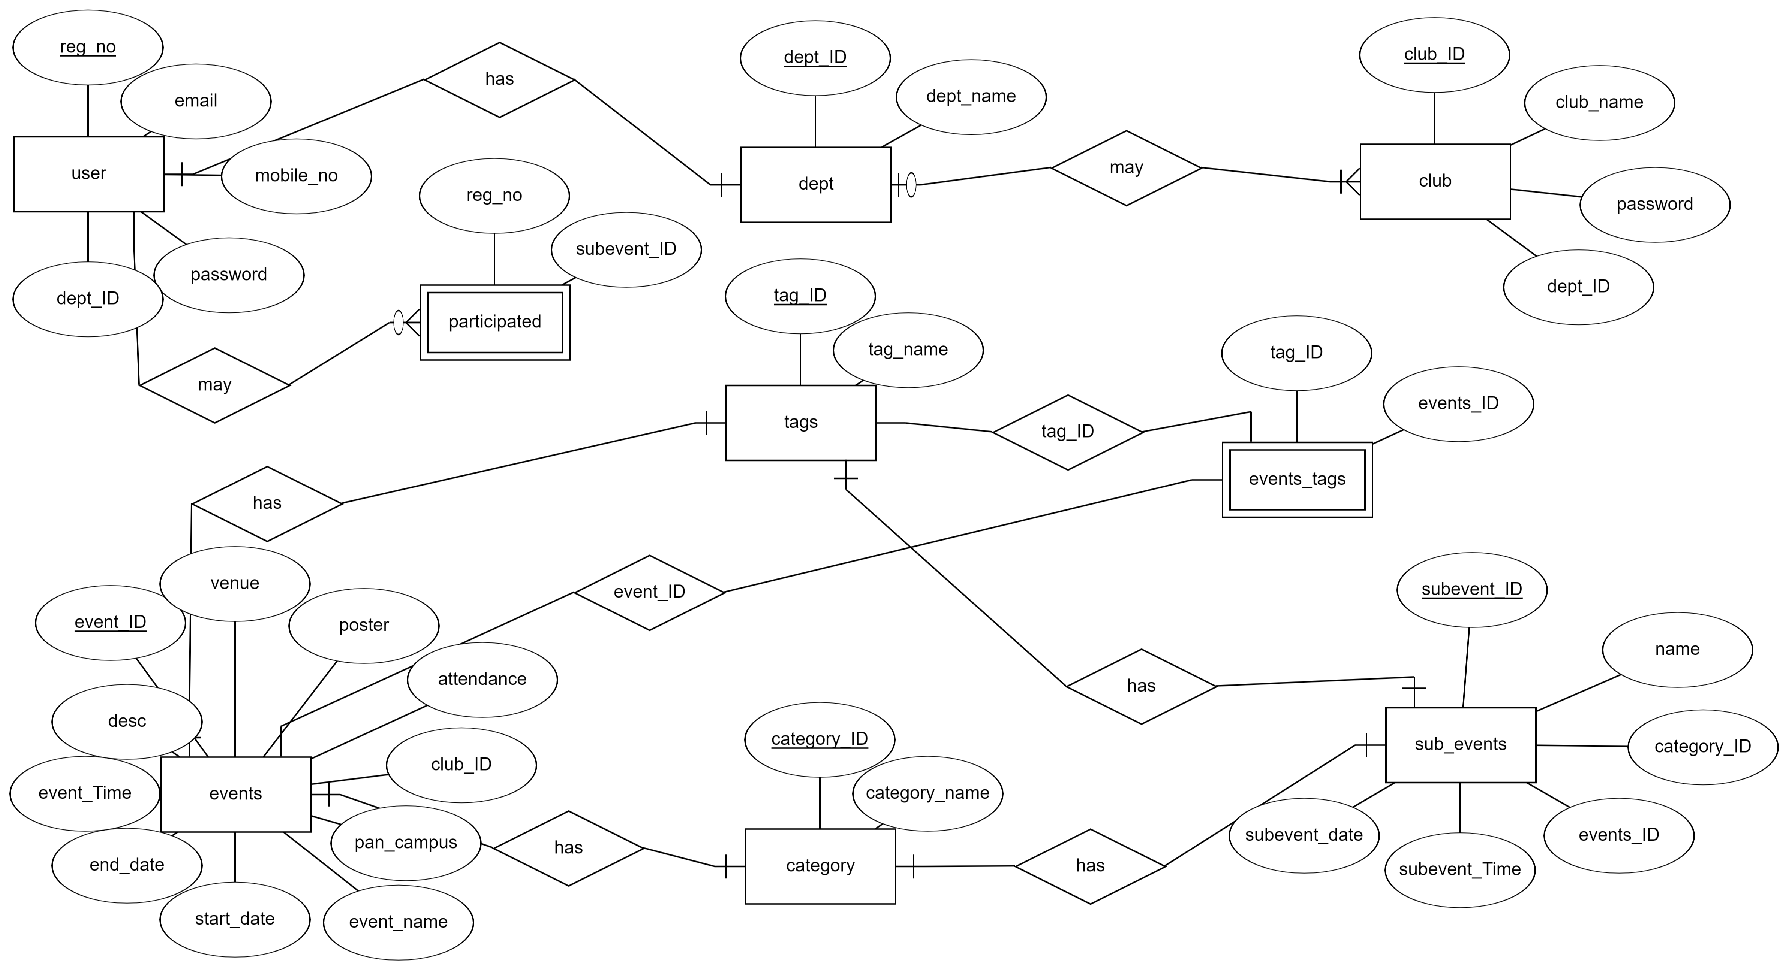
DATABASE
ER DIAGRAM

Slide 24
Data Dictionary
Tables used in the Database:
1. User (3NF)
2. Dept (3NF)
3. Club (3NF)
4. Events (3NF)
5. Tags (3NF)
6. Category (3NF)
7. Subevents (3NF)
8. Participated (2NF)
9. Events_tags (2NF)

Slide 25
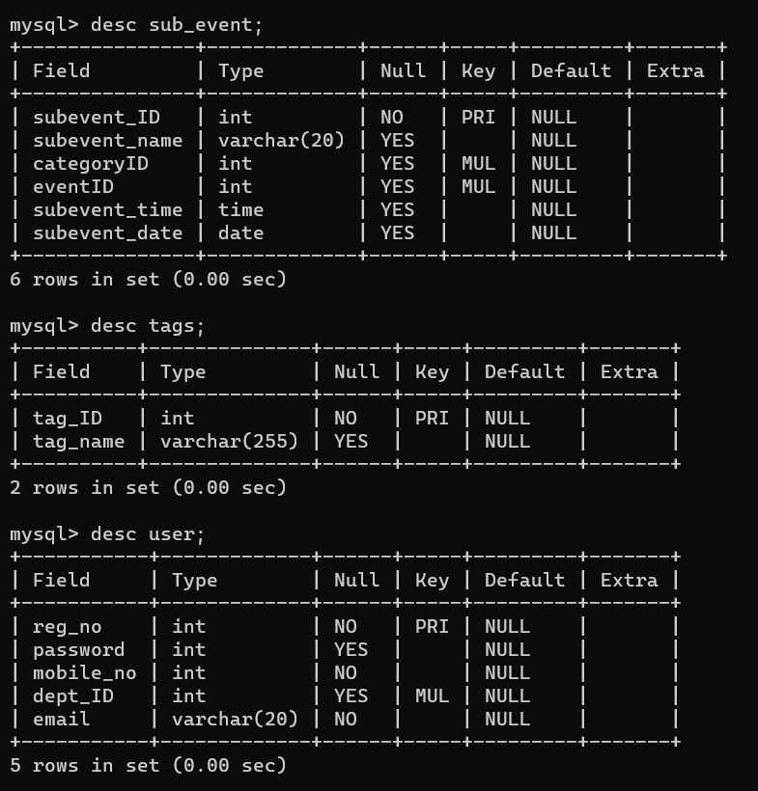
TABLE DESCRIPTION
SUB EVENTS
TAGS
USER

Slide 26
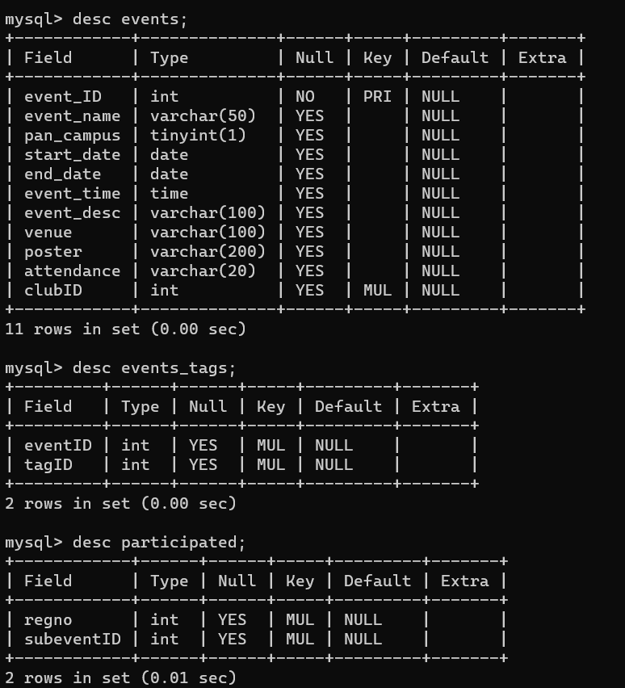
TABLE DESCRIPTION
4) EVENTS
5) EVENTS_TAGS
6) PARTICIPATED

Slide 27
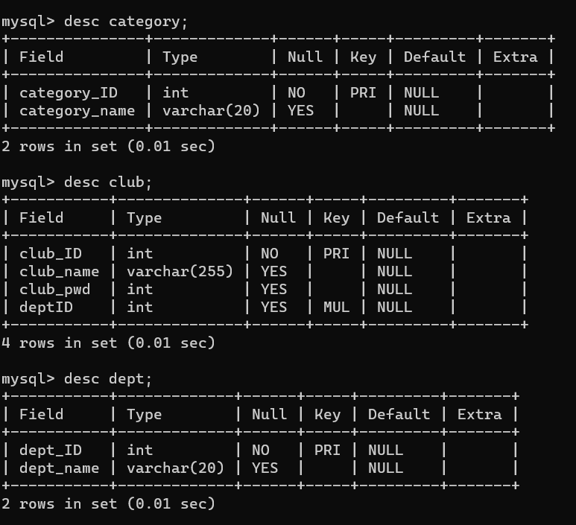
TABLE DESCRIPTION
7) CATEGORY
8) CLUB
9) DEPT

Slide 28
LIMITATIONS OF PROPOSED SYSTEMS
If the system crashes or fails to load then it will create a chaos regarding organizers to make students register for the fest and will make fests less unknown
As it is a standalone app it makes the user to add one more application to their list
As the students register on our website and the hosts do not need to go to classes and make announcements it reduces human interaction and makes us more leaned towards our phones and desktops

Slide 29
THANK YOU

